Slide 1

Psychological Measurement Workshop 1

Slide 2
Today’s Session
Hour 1:
Consider definitions of behaviours
Think of situations in which we might judge behaviours
Think of the types of labels we attach to behaviours
Hour 2
Complete a fun(ish) online personality questionnaire
Interpret and critically evaluate the feedback
Open Jamovi

Slide 3
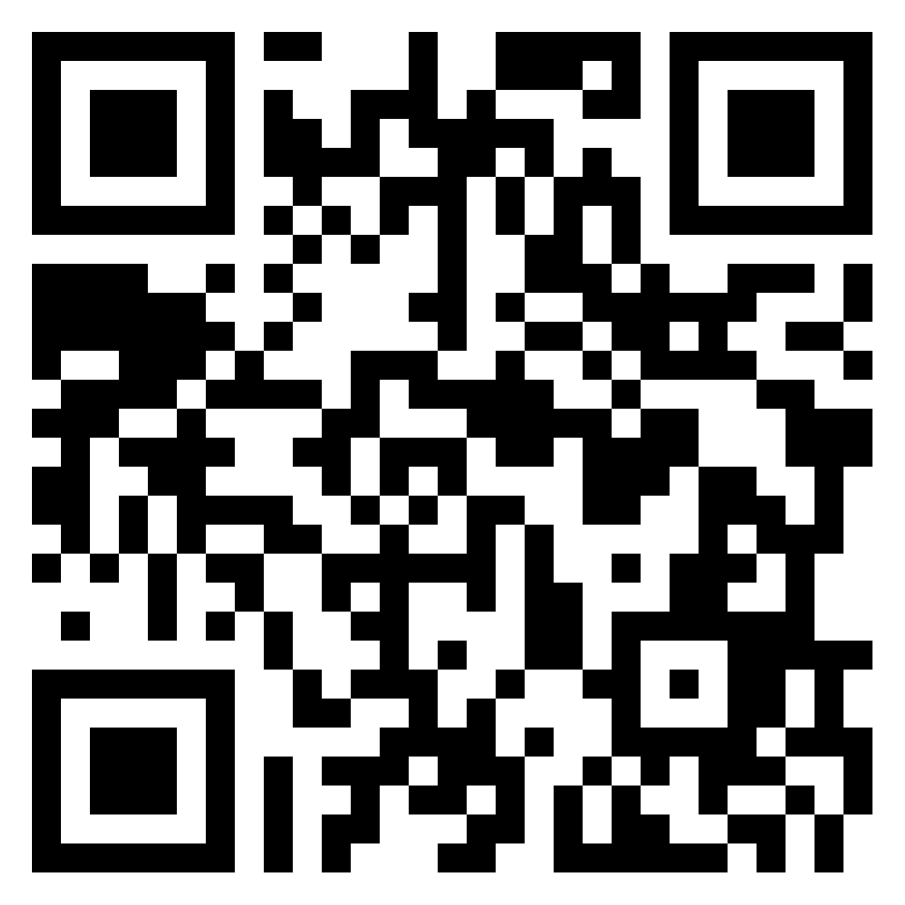
But First - Reflections
Group 1
Something you’ve learned
Something you’ve enjoyed
Something you’ve found challenging
https://tinyurl.com/3k6yxs6y

Slide 4
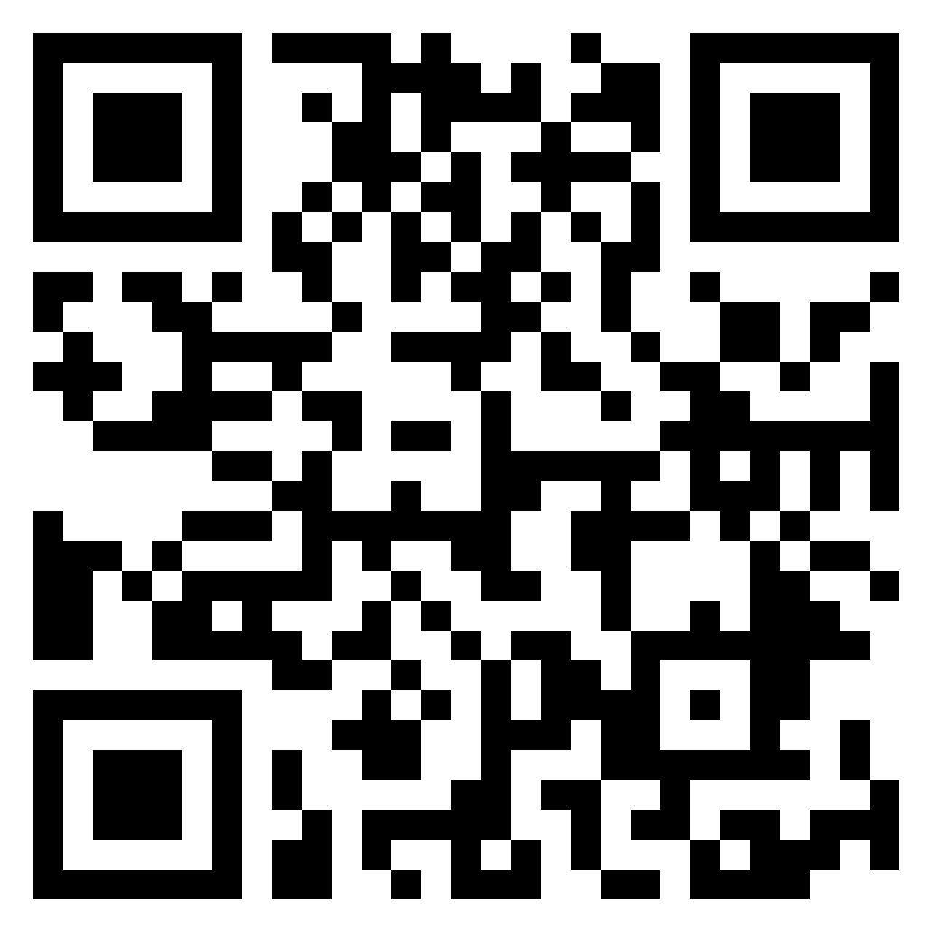
But First - Reflections
Something you’ve learned
Something you’ve enjoyed
Something you’ve found challenging
Group 2
https://tinyurl.com/hjbynnnw

Slide 5
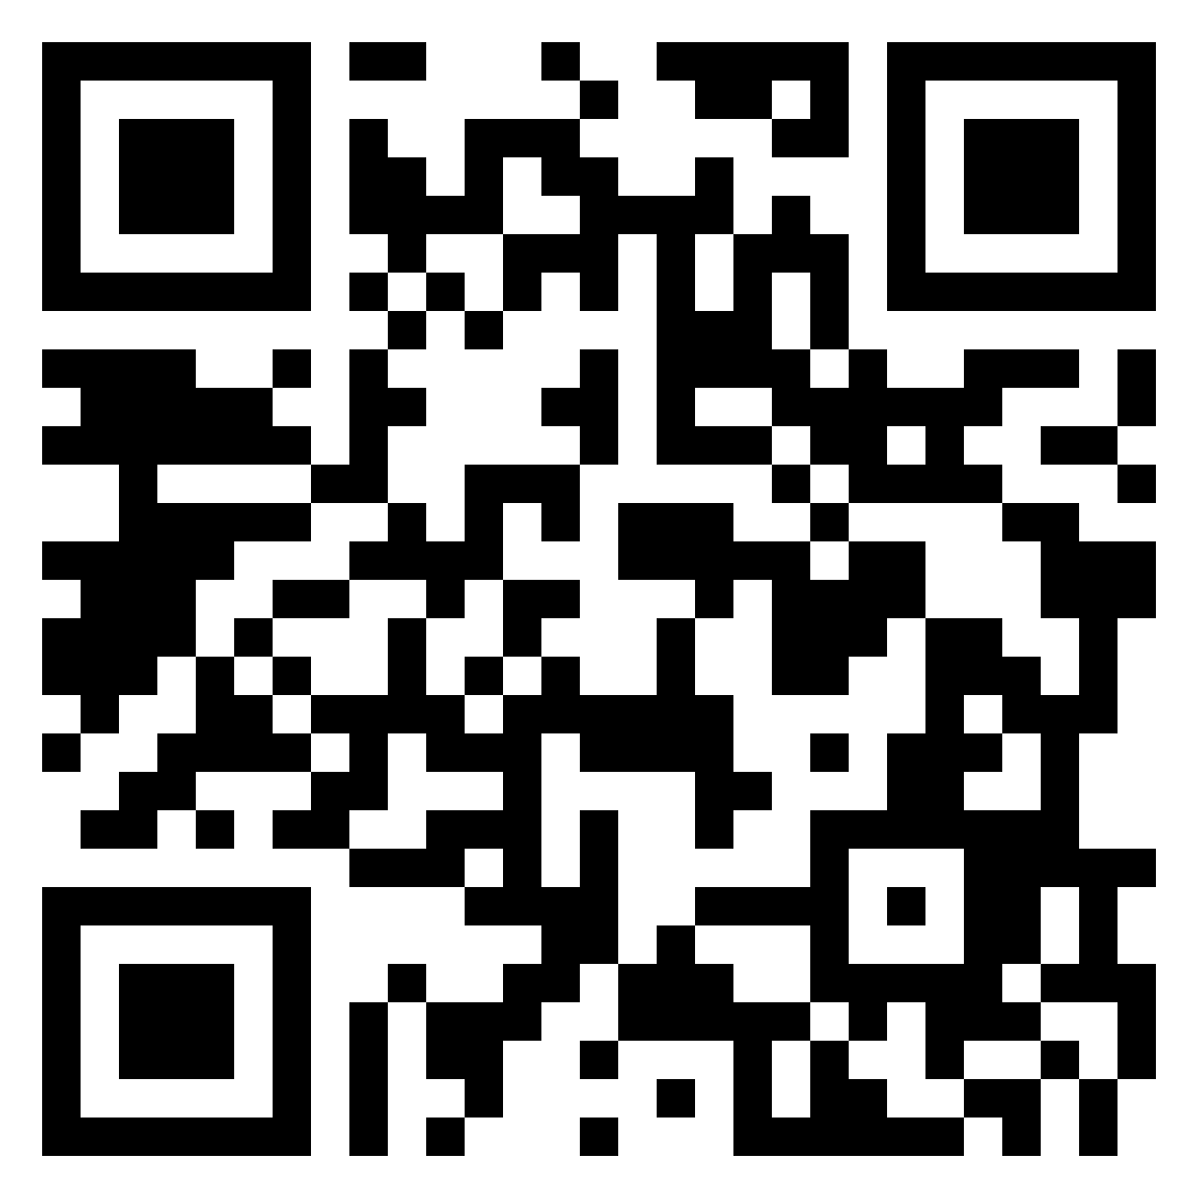
Activity 1
Take a few minutes to consider:
What constitutes a human behaviour?
How might we measure this?
Scan QR Code
Or Click
Link To Padlet
Or Type
tinyurl.com/yet3hf93

Slide 6

Activity 1
Take a few minutes to consider:
What constitutes a human behaviour?
How might we measure this?

Slide 7
Padlet Activity
Behaviour
Measure
Behaviour is the actual physical occurrence (Phenomena)
Measure is the method we use to quantify the behaviour (produces data)

Slide 8
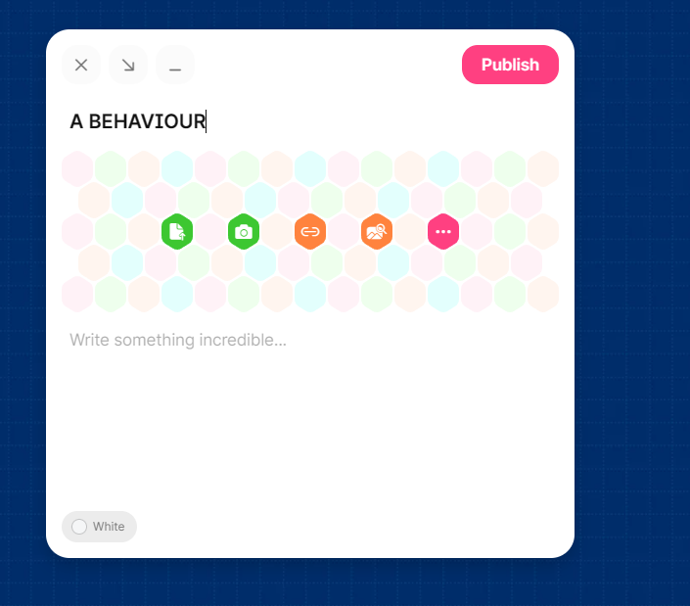

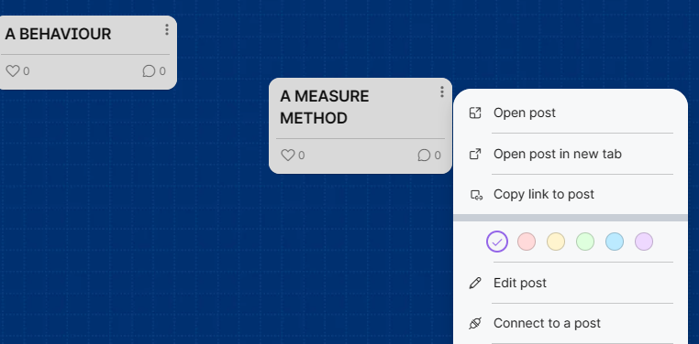
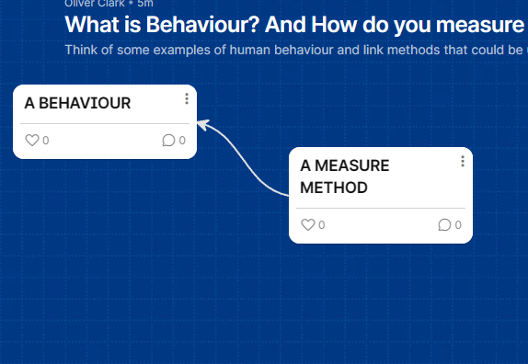
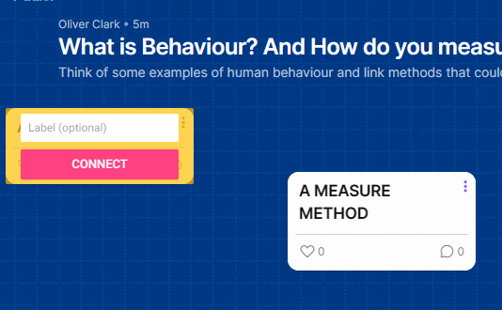
1
Click here->
2
3
Add a post and publish
Repeat and click the three vertical dots – select connect to a post
4
Select Post to connect to (add label if you like)
5
Voila

Slide 9
Discussion Point
What is the difference between measuring ‘behaviours’ and ‘measuring the mind’?

Slide 10
Activity 1.b
What psychological states might these
behaviours indicate?
Add to existing Padlet:
Scan QR Code
Or Click
Link To Padlet
Or Type
tinyurl.com/yet3hf93

